Slide 1



Parallel Patterns using
Heterogeneous Computing
Andre Vermeulen

Slide 2
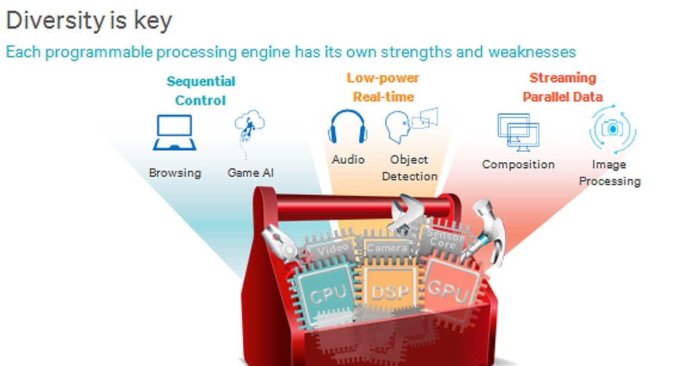
What is Heterogeneous Computing?

Slide 3
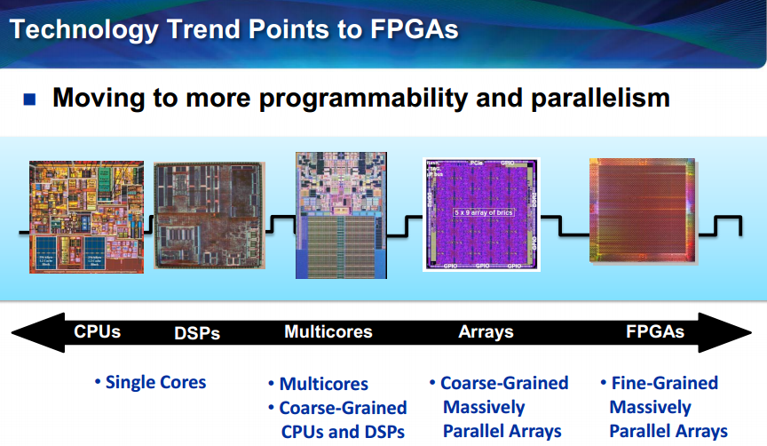
Evolution in Computing?

Slide 4
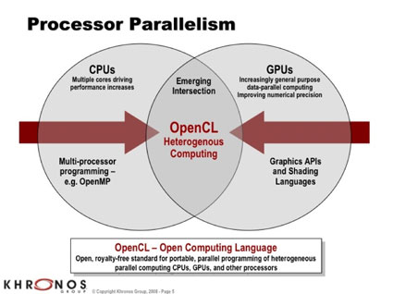
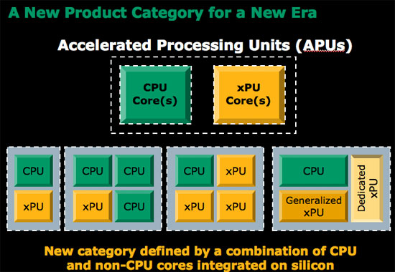
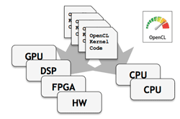
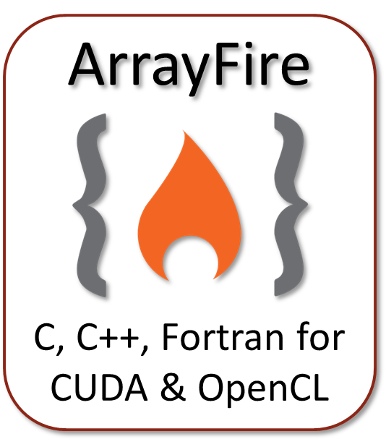
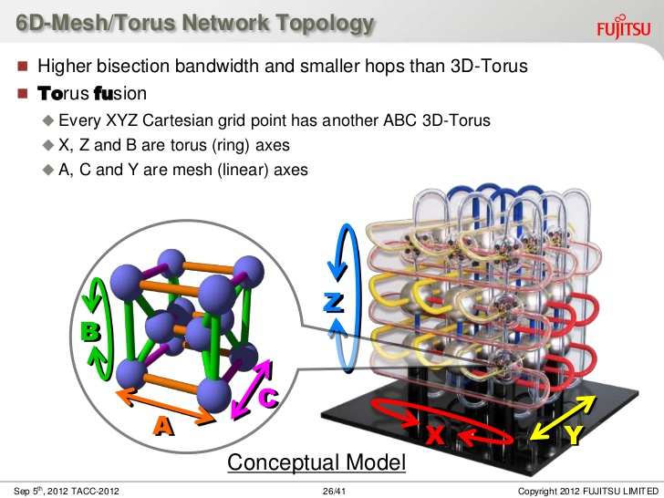
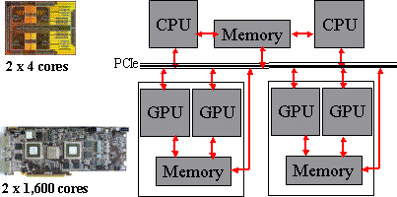
St Andrew / Dundee Research

Slide 5
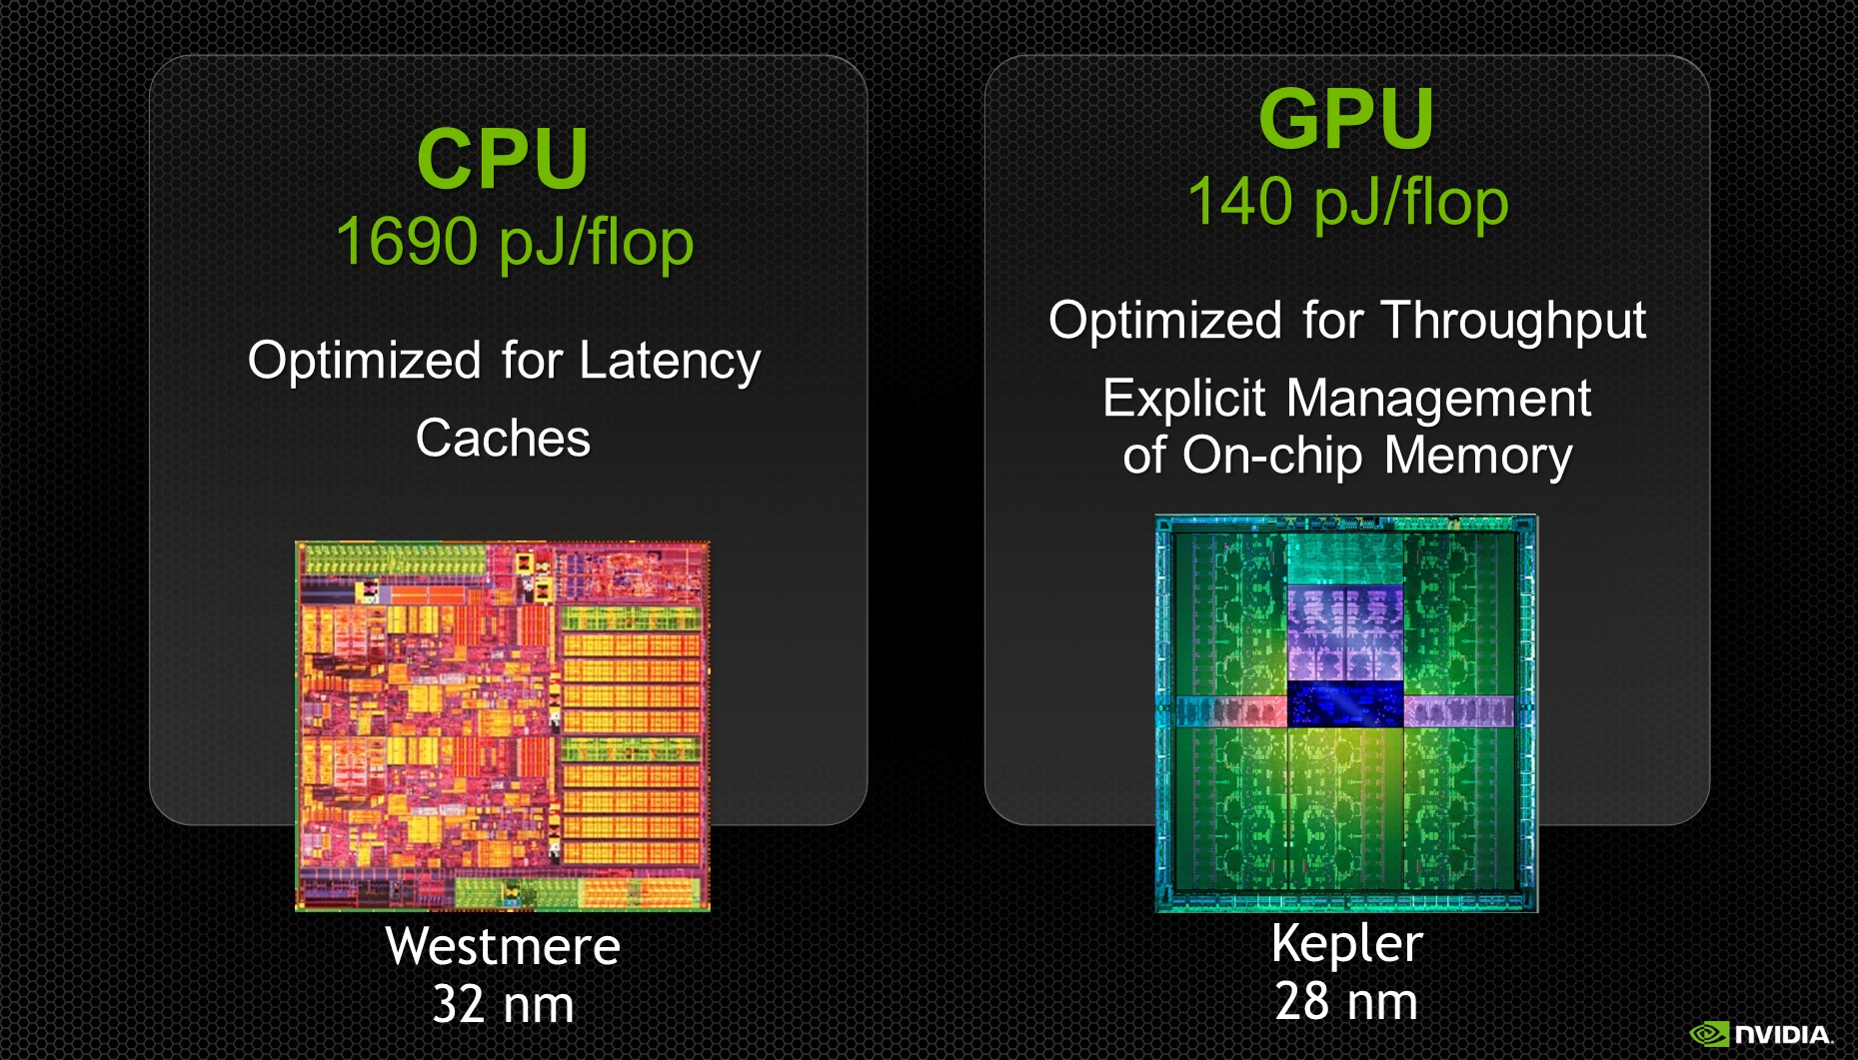
Lower Power Usage (12x)

Slide 6
Question
&
Answer
Andre Vermeulen afvermeulen@dundee.ac.uk

Slide 7


Slide 8
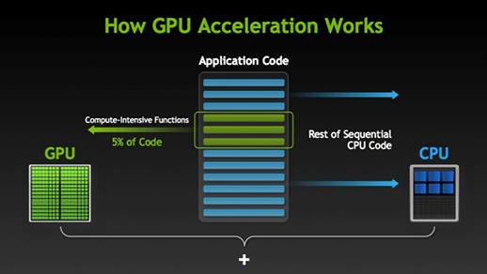
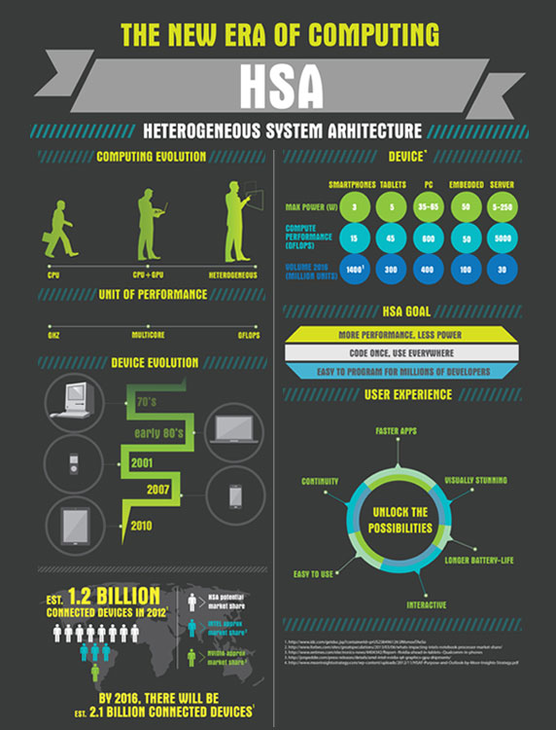
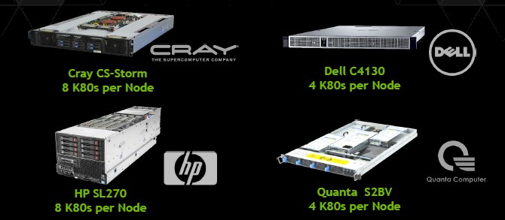
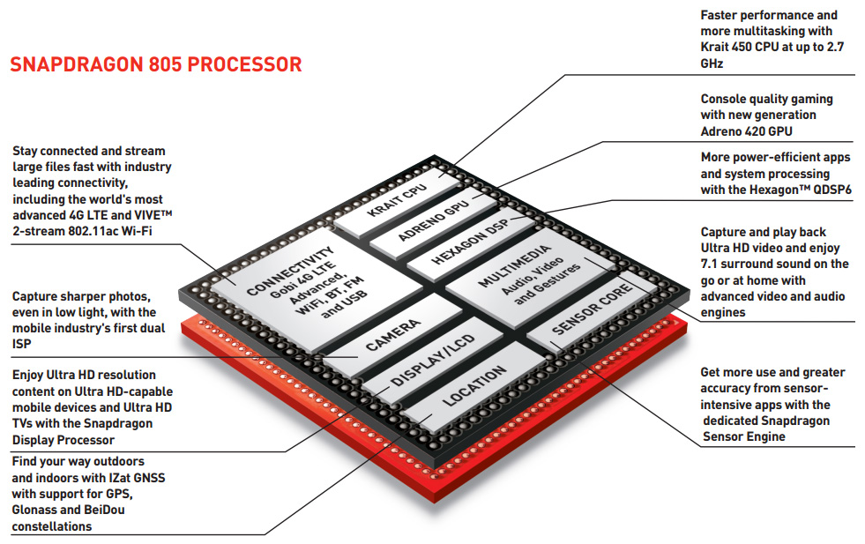

Slide 9
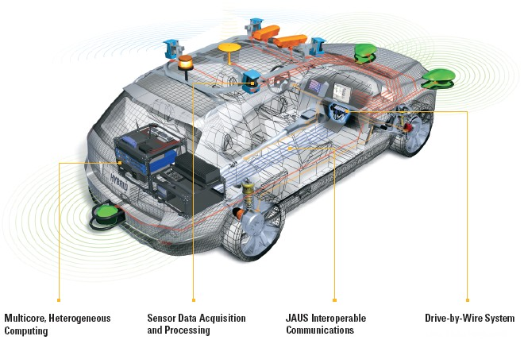
Practical Implementation

Slide 10
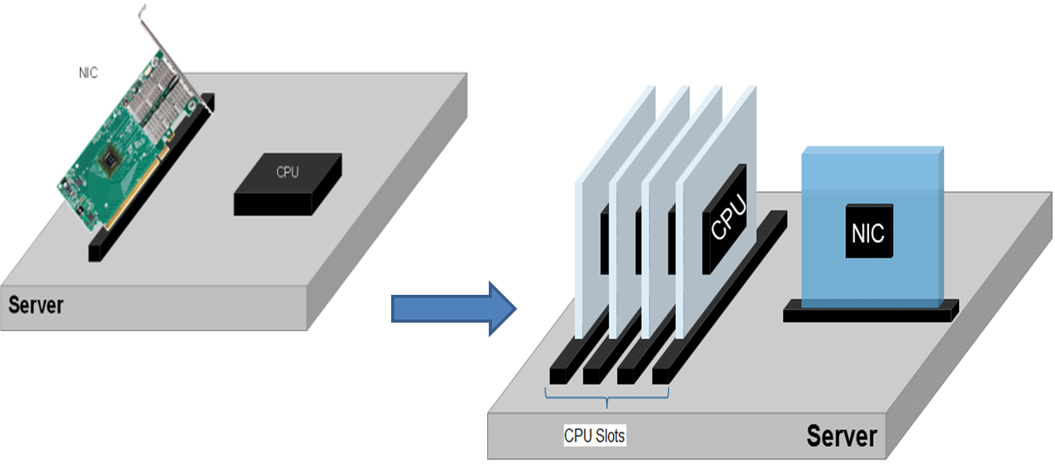
Change in Configuration

Slide 11
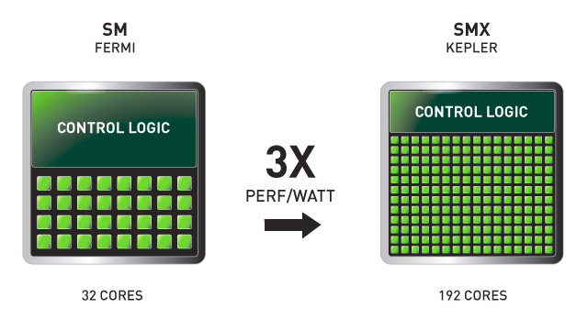

Slide 12
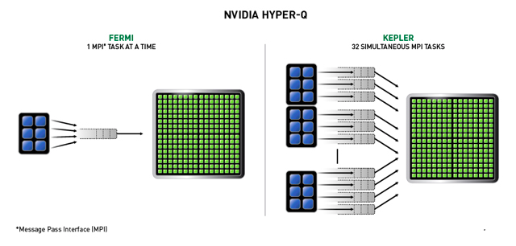
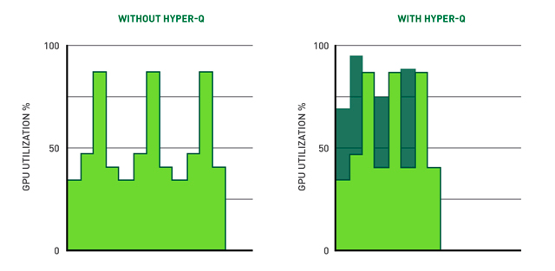

Slide 13
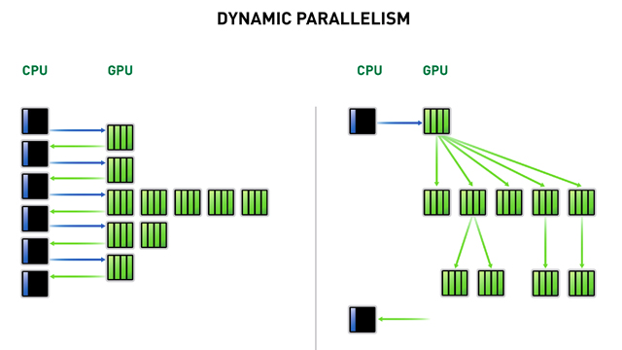

Slide 14
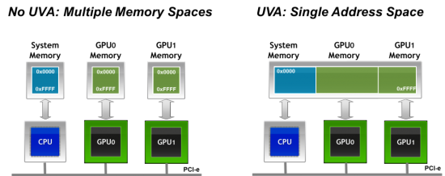
Unified Virtual Addressing (UVA)

Slide 15
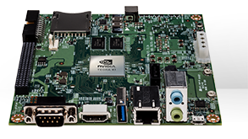
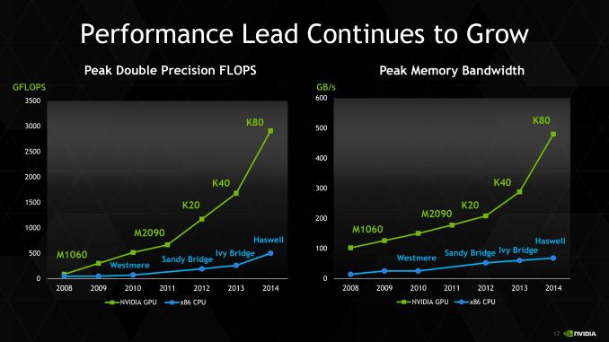
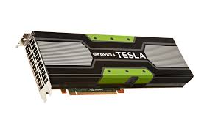
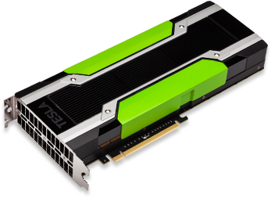
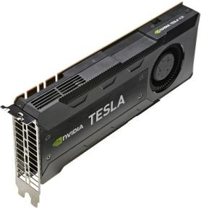
Nvidia Jetson - 192 CUDA cores
326 Gflops using 15 Watt
Nvidia K20 – 2,496 CUDA cores
3520 Gflops using 225 Watt
Nvidia K40 – 2,880 CUDA cores
5000 Gflops at 235W
Nvidia K80 - 4,992 CUDA cores
8740 Gflops using 300W

Slide 16


